Slide 1

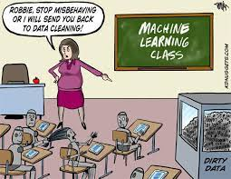
Machine Learning
Dr. Yilmaz
11/27/2023

Slide 2
CLASSIFICATION
1R
Naive Bayes
Decision Trees
Random Forest
K-Nearest Neighbors (KNN)

Slide 3
K-Nearest Neighbors (KNN)
Supervised Learning Algorithm
Labels exists and uses the labels for classification
Can be used for classification (dependent variable discrete)
or for regression (dependent variable continuous)
Predict cat/dog vs Predict salary
Lazy Learner
Does not build model
You start working only when you have a test instance to label
Then use the entire dataset to label the given instances
Computationally expensive

Slide 4
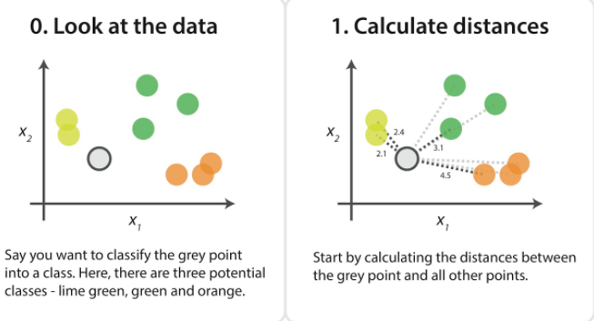
KNN Classification Algorithm
Notes:
https://www.analyticsvidhya.com/blog/2021/05/20-questions-to-test-your-skills-on-k-nearest-neighbour/

Slide 5
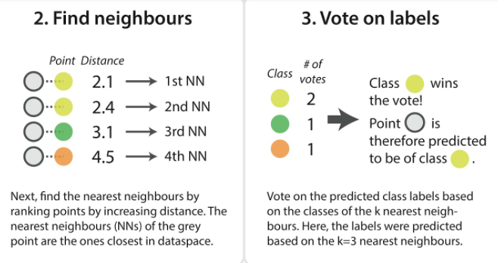
KNN Algorithm

Slide 6
KNN Algorithm:
Uses Labels
Hence Supervised Learning!

Slide 7
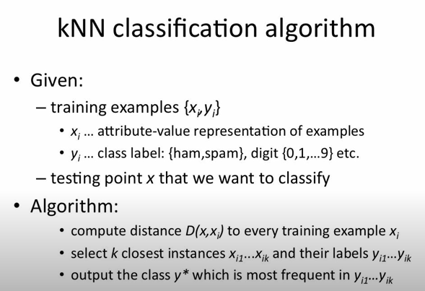

Slide 8
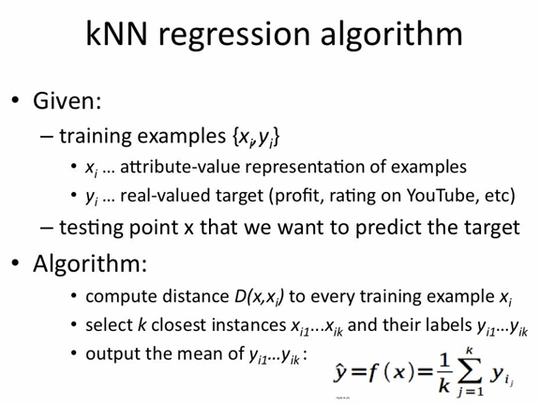
Notes:
Instead of predicting the class we predict a number

Slide 9
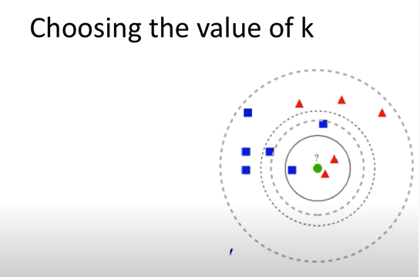
KNN Algorithm
k=3 green circle classified as ?
k=5 green circle classified as ?
k=11 green circle classified as ?

Slide 10
KNN Algorithm
k=3 green circle classified as ?
Red
k=5 green circle classified as ?
Blue
k=11 green circle classified as ?
Blue
As k varies, classification changes.
Performance depends on the value of k you pick.

Slide 11
KNN Algorithm: Pros and Cons
Pros:
Makes no assumption about data
Naive Bayes assumes that attributes are independent of each other
Decision Trees assumes greedy strategy: one attribute at a time
KNN allows data to speak for itself
Simple
Not bad performance

Slide 12
KNN Algorithm: Pros and Cons
Cons:
Computationally expensive
The bigger the training data, the slower the testing time
It needs to store all the training data (as opposed to just the model)
Determining k

Slide 13
CLASSIFICATION
1R
Naive Bayes
Decision Trees
Random Forest
K-nearest Neighbors (KNN)
Finished

Slide 14
Plan:
Lab 9: KNN assigned
Next time:
Unsupervised Learning Algorithm: K-means

Slide 15
References:
https://www.baeldung.com/cs/k-nearest-neighbors
https://towardsdatascience.com/the-use-of-knn-for-missing-values-cf33d935c637

